Slide 1

WPF Layouts
Containers, Panels, GridPsliiters
SoftUni Team
Technical Trainers
Software University
http://softuni.bg

Slide 2
Table of Contents
StackPanel
Wrap Panel
Dock Panel
Canvas Panel
Containers
Grid Splitters
TreeView
GridView

Slide 3

Containers

Slide 4
Containers
Containers are things that contain other things
Like divs and sections in HTML
They hold other controls / elements
Used to build the layout of the application
Every container is given a space to consume
All his children are in this space

Slide 5
XAML Containers
In XAML containers are called Panels
Three common types of panels
Panels with absolute coordinates
Panels with stacking order
Panels with proportional or with rows/columns
Absolute coordinates Panels
Canvas
Controls inside the canvas are arranged based on the Canvas position and size

Slide 6
XAML Containers (2)
Stacking Panels
StackPanel, DockPanel, WrapPanel
Elements are arranged in a stacking order
i.e. first come goes in the beginning
Proportional Panels
Grid and UniformGrid
Arrange the elements in a table-like layout

Slide 7

Canvas

Slide 8
Canvas
The Canvas is a layout container
An element that holds other (child) elements
Elements inside are positioned using fixed coordinates
Places elements behind or in front of others
Supports size and clipping
Can be positioned explicitly using coordinates
Left, Right, Top and Bottom.

Slide 9
Canvas Example
<Canvas Width="300" Height="250" >
<Rectangle Canvas.Left="30" Canvas.Top="30" Fill="Red" Width="50" Height = "50" />
<Rectangle Canvas.Right="30" Canvas.Top="30" Fill="Green" Width="50" Height="50" />
<Rectangle Canvas.Left="30" Canvas.Bottom="30" Fill="Black" Width="50" Height="50" />
<Rectangle Canvas.Right="30" Canvas.Bottom="30" Fill="Blue" Width="50" Height="50" />
</Canvas>

Slide 10
Z-Index
Placing elements behind or in front of others depends on the Z-index
Customize the z-order of any child element using Canvas.ZIndex attached property
4
3
2
1

Slide 11
Z-Index - Example
<Canvas>
<Ellipse Canvas.ZIndex="1" Fill="Gainsboro" Canvas.Left="25" Canvas.Top="25" Width="200" Height="200" />
<Rectangle Canvas.ZIndex ="2" Fill="LightBlue" Canvas.Left="25" Canvas.Top="25" Width="50" Height="50" />
<Rectangle Canvas.ZIndex ="3" Fill="LightCoral" Canvas.Left="50" Canvas.Top="50" Width="50" Height="50" />
<Rectangle Canvas.ZIndex ="4" Fill="LightCyan" Canvas.Left="75" Canvas.Top="75" Width="50" Height="50" />
</Canvas>

Slide 12

Panels

Slide 13
StackPanel
The StackPanel arranges the elements in one row/column
Depends on the orientation property
Can set flow orientation
Vertical or Horizontal
<StackPanel Orientation="Vertical">
<Rectangle Fill="Yellow" Width="50" Height="50" />
<Rectangle Fill="Green" Width="50" Height="50" />
<Rectangle Fill="Blue" Width="50" Height="50" />
</StackPanel>

Slide 14
WrapPanel
The StackPanel arranges the elements in the next row/column
Depends on the orientation property
Can set flow orientation
Vertical or Horizontal
<WrapPanel Orientation="Vertical">
<Rectangle Fill="Yellow" Width="50" Height="50" />
<Rectangle Fill="Green" Width="50" Height="50" />
<Rectangle Fill="Blue" Width="50" Height="50" />
</WrapPanel>

Slide 15
DockPanel
The DockPanel provides docking of elements to the left, right, top or bottom of the panel
To Defined by the attached property Dock
<DockPanel>
<Button DockPanel.Dock="Left">Left</Button>
<Button DockPanel.Dock="Top">Top</Button>
<Button DockPanel.Dock="Right">Right</Button>
<Button DockPanel.Dock="Bottom">Bottom</Button>
<Button>Center</Button>
</DockPanel>

Slide 16

Grids

Slide 17
Grid Panel
The most powerful layout container in XAML
Everything can be done with Grid
Arranges the elements in a table-like layout
Predefined number of rows and columns
Each element has explicitly set grid row/column
Using the attached properties
Grid.Row
Grid.Column

Slide 18
Grid Panel - Example
<Grid.ColumnDefinitions>
<ColumnDefinition Width="2*" />
<ColumnDefinition Width="1*" />
</Grid.ColumnDefinitions>
<Grid.RowDefinitions>
<RowDefinition Height="2*" />
<RowDefinition Height="1*" />
</Grid.RowDefinitions>
<Button Grid.Row="0" Grid.Column="0">Button 1</Button>
<Button Grid.Row="0" Grid.Column="1">Button 2</Button>
<Button Grid.Row="1" Grid.Column="0">Button 3</Button>
<Button Grid.Row="1" Grid.Column="1">Button 4</Button>

Slide 19
UniformGrid Panel
Much like the common Grid panel
Cannot set position explicitly
Each elements is with the same size
Fills the elements depending of the number of rows/columns
<UniformGrid Rows="2">
<Button>Button 1</Button>
<Button>Button 2</Button>
<Button>Button 3</Button>
<Button>Button 4</Button>
</UniformGrid>

Slide 20

TabControl

Slide 21
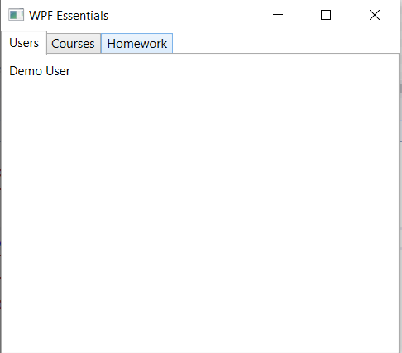
TabControl
It is useful for switching between multiple pages
Usually placed on the top
TabStripPlacement property can set their placement
Left
Right
Bottom

Slide 22
TabControl - Example
<TabControl>
<TabItem Header="Users">
<Label Content="Demo User" />
</TabItem>
<TabItem Header="Courses" />
<TabItem Header="Homework" />
</TabControl>
<TabControl TabStripPlacement="Right"></TabControl>

Slide 23

TreeView

Slide 24
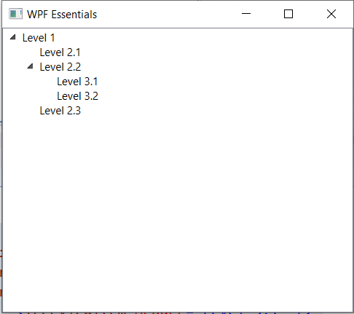
TreeView
Presents a hierarchical view
Data with nodes that can be expanded and collapsed
Important events:
Expanded
Collapsed
Selected
Unselected

Slide 25
TreeView Example
<TreeView>
<TreeViewItem Header="Level 1">
<TreeViewItem Header="Level 2.1" />
<TreeViewItem Header="Level 2.2">
<TreeViewItem Header="Level 3.1" />
<TreeViewItem Header="Level 3.2" />
</TreeViewItem>
<TreeViewItem Header="Level 2.3" />
</TreeViewItem>
</TreeView>

Slide 26
ListView

Slide 27
ListView
It derives from ListBox
It uses the Extended SelectionMode by default
View property
Enable customize the view in a richer way
The View property is of type ViewBase, an abstract class

Slide 28
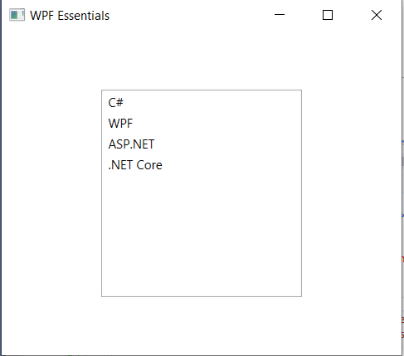
ContextMenu - Example
<ListView Width=" 200 " Height="200">
<ListViewItem Content="C />
<ListViewItem Content="WPF"/>
<ListViewItem Content="ASP.NET"/>
<ListViewItem Content=".NET Core"/>
</ListView>

Slide 29

Summary
StackPanel
Wrap Panel
Dock Panel
Canvas Panel
Containers
Grid Splitters
TreeView
GridView
…
…
…

Slide 30
https://softuni.bg/trainings/courses

Slide 31












SoftUni Diamond Partners
Notes:
31

Slide 32




SoftUni Organizational Partners
Notes:
32

Slide 33




Trainings @ Software University (SoftUni)
Software University – High-Quality Education and Employment Opportunities
softuni.bg
Software University Foundation
http://softuni.foundation/
Software University @ Facebook
facebook.com/SoftwareUniversity
Software University Forums
forum.softuni.bg

Slide 34

License
This course (slides, examples, demos, exercises, homework, documents, videos and other assets) is copyrighted content
Unauthorized copy, reproduction or use is illegal
© SoftUni – https://softuni.org
© Software University – https://softuni.bg
Notes:
34

